Slide 1
Roots of Rotary RLI Part 1

Slide 2
Agenda
Presenter name - Rotary Club of club name
Goals for Today
Share some significant historical information on the formation of Rotary
Introduce Rotary’s principles
Reflect on the importance of having knowledge of the History of Rotary and our guiding principles enhance our Rotary experience
Notes:
2 min
Introduce
Review Goals

Slide 3
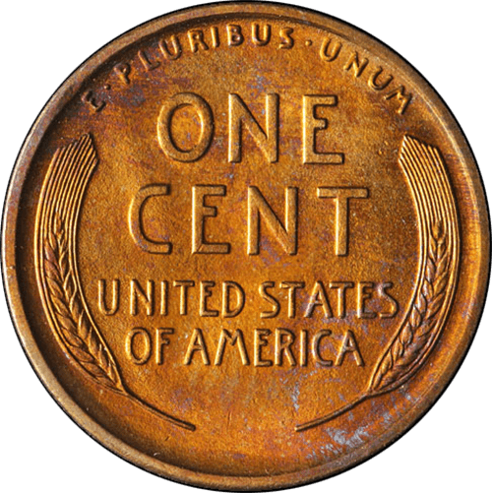
A Penny for Your Thoughts?
Notes:
5-min Warmup
Give each person a paper penny ( see facilitator materials)
Write and significant date to you on the penny
Go around the room and let each quickly tell why that year is important.
I f this is the first session of the day, ask them to say their name and Rotary club too.
Transition to our topics.

Slide 4
How has Rotary changed from 1905 to today?
Notes:
30 min on Timeline activity
Transition to History and TimeLine activity
Sometimes I think of Rotary as a men’s club that got out of hand!
I believe that Paul Harris would be very proud of what we have become.
Let’s learn how “We” Happened.
Next we will take a look at the people and events that led to the creation of our Rotary organization and these important principles that guide our work.

Slide 5
Exploring our History
Activity
Create a Rotary Timeline
Share the information on your card
and hang your card on the timeline
Begin with 1905!
Notes:
https://www.rotary.org/en/rotarys-timeline-cultivating-leaders
Also add card on our Rotary Masterbrand developed

Slide 6
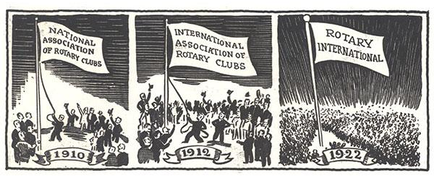
Share a few milestones you learned from the Rotary Timeline

Slide 7
Did you know that being a member of Rotary comes with a set of instructions?
Notes:
10 Min on Guiding Principles
Ask: what do you think a few of these instructions might be?
Take 3-4 quick responses.
Let’s take a quick look at these “instructions” All of these will be discussed on more depth as you move through your RLI workshops.

Slide 8
Notes:
Our Rotary Core Values

Slide 9
Notes:
The Object of Rotary.
Some clubs also have a banner of this beside the 4-way test.

Slide 10
Notes:
The Rotary Code of Conduct
Probably one of our lesser-known documents

Slide 11
Notes:
Our 4-way test
Sor of sums up the previous documents

Slide 12
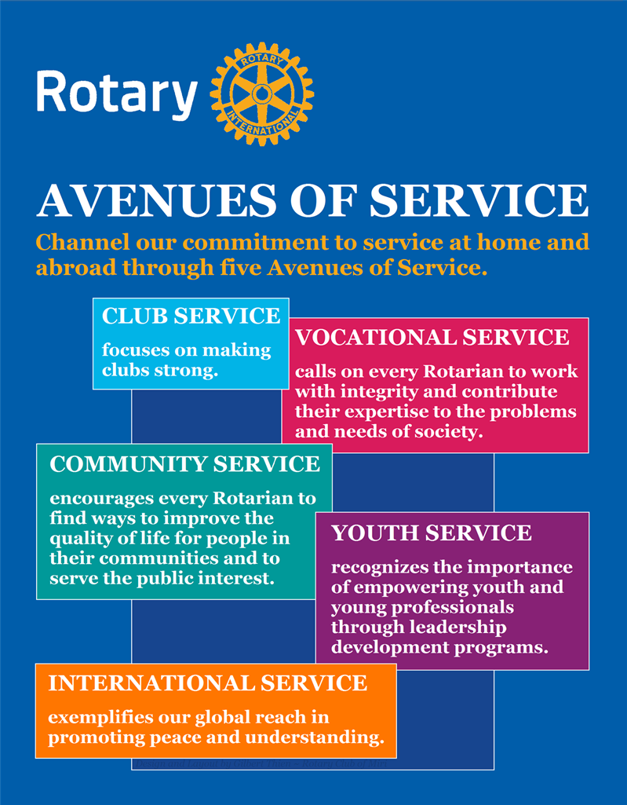
Notes:
The Avenues of Service describes How Rotarians Serve our Community and the World

Slide 13
Areas of Focus
Notes:
The Areas of Focus gives some clarity to our Avenues of Service

Slide 14
What are some common threads throughout all of these “instructions” ?
Notes:
Debrief before moving into the TimeLine Activity

Slide 15
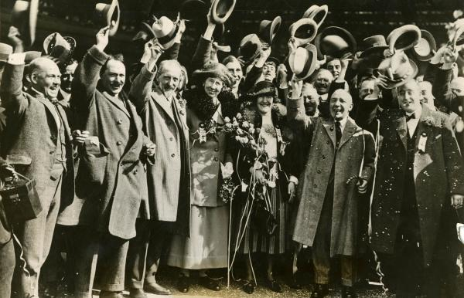
Reflection Activity
Create 2 Groups:
For 5 minutes discuss in your group
Group 1
Discuss how your knowledge of our Guiding Principles of The Rotary Code of Conduct, Object of Rotary, Avenues of Service help your perception of what it means to be a Rotarian.
Group 2
Discuss how your knowledge of some of Rotary’s historical events help your perception of what it means to be a Rotarian.
Share: 2 min each group
Notes:
7 Minutes on Reflection Activity and thank you.

Slide 16
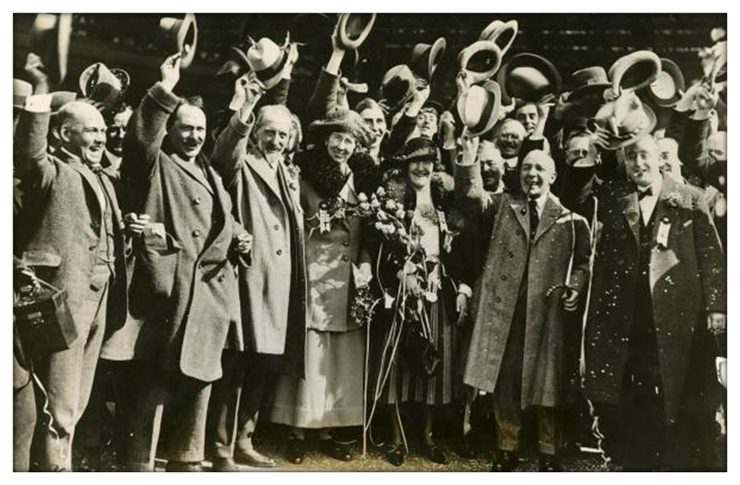
Thank You!! Best wishes along your RLI Journey. Please remember to complete the online survey.

